Slide 1

Security Assessment Priciples

Slide 2
Agenda
Planning Security Assessments
Gathering Information About the Organization
Penetration Testing for Intrusive Attacks
Case Study: Assessing Network Security for Northwind Traders

Slide 3
Planning Security Assessments
Planning Security Assessments
Gathering Information About the Organization
Penetration Testing for Intrusive Attacks
Case Study: Assessing Network Security for Northwind Traders

Slide 4


Why Does Network Security Fail?
Network security fails in several common areas, including:
Human awareness
Policy factors
Hardware or software misconfigurations
Poor assumptions
Ignorance
Failure to stay up-to-date

Slide 5
Understanding Defense-in-Depth
Using a layered approach:
Increases an attacker’s risk of detection
Reduces an attacker’s chance of success
Guards, locks, tracking devices
Firewalls, boarder routers, VPNs with quarantine procedures
Network segments, NIDS
OS hardening, authentication,
security update management, antivirus updates, auditing
Application hardening
Strong passwords, ACLs, backup and restore strategy

Slide 6

Why Perform Security Assessments?
Security assessments can:
Answer the questions “Is our network secure?” and “How do we know that our network is secure?”
Provide a baseline to help improve security
Find configuration mistakes or missing security updates
Reveal unexpected weaknesses in your organization’s security
Ensure regulatory compliance

Slide 7
Planning a Security Assessment
Project phase | Planning elements
Pre-assessment | Scope Goals Timelines Ground rules
Assessment | Choose technologies Perform assessment Organize results
Preparing results | Estimate risk presented by discovered weaknesses Create a plan for remediation Identify vulnerabilities that have not been remediated Determine improvement in network security over time
Reporting your findings | Create final report Present your findings Arrange for next assessment

Slide 8
Understanding the Security Assessment Scope
Components | Example
Target | All servers running: Windows 2000 Server Windows Server 2003
Target area | All servers on the subnets: 192.168.0.0/24 192.168.1.0/24
Timeline | Scanning will take place from June 3rd to June 10th during non-critical business hours
Vulnerabilities to scan for | RPC-over-DCOM vulnerability (MS 03-026) Anonymous SAM enumeration Guest account enabled Greater than 10 accounts in the local Administrator group

Slide 9
Understanding Security Assessment Goals
Project goal
All computers running Windows 2000 Server and Windows Server 2003 on the subnets 192.168.0.0/24 and 192.168.1.0/24 will be scanned for the following vulnerabilities and will be remediated as stated
Vulnerability | Remediation
RPC-over-DCOM vulnerability (MS 03-026) | Install Microsoft security updates 03-026 and 03-39
Anonymous SAM enumeration | Configure RestrictAnonymous to: 2 on Windows 2000 Server 1 on Windows Server 2003
Guest account enabled | Disable Guest account
Greater than 10 accounts in the local administrator group | Minimize the number of accounts on the administrators group

Slide 10

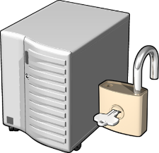

Types of Security Assessments
Vulnerability scanning:
Focuses on known weaknesses
Can be automated
Does not necessarily require expertise
Penetration testing:
Focuses on known and unknown weaknesses
Requires highly skilled testers
Carries tremendous legal burden in certain countries/organizations
IT security auditing:
Focuses on security policies and procedures
Used to provide evidence for industry regulations

Slide 11


Using Vulnerability Scanning to Assess Network Security
Develop a process for vulnerability scanning that will do the following:
Detect vulnerabilities
Assign risk levels to discovered vulnerabilities
Identify vulnerabilities that have not been remediated
Determine improvement in network security over time

Slide 12
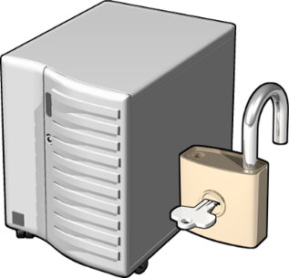
Using Penetration Testing to Assess Network Security
Steps to a successful penetration test include:
Determine how the attacker is most likely to go about attacking a network or an application
1
2
Locate areas of weakness in network or application defenses
3
Determine how an attacker could exploit weaknesses
4
Locate assets that could be accessed, altered, or destroyed
5
Determine whether the attack was detected
6
Determine what the attack footprint looks like
7
Make recommendations

Slide 13

Understanding Components of a Security Audit
Security Policy Model
Operations
Documentation
Implementation
Technology
Process
Start with policy
Build process
Apply technology
Policy

Slide 14
Implementing an IT Security Audit
Compare each area to standards and best practices
Security policy
Documented procedures
Operations
What you must do
What you say you do
What you really do

Slide 15

Reporting Security Assessment Findings
Organize information into the following reporting framework:
Define the vulnerability
Document mitigation plans
Identify where changes should occur
Assign responsibility for implementing approved recommendations
Recommend a time for the next security assessment

Slide 16
Gathering Information About the Organization
Planning Security Assessments
Gathering Information About the Organization
Penetration Testing for Intrusive Attacks
Case Study: Assessing Network Security for Northwind Traders

Slide 17

What Is a Nonintrusive Attack?
Nonintrusive attack: The intent to gain information about an organization’s network in preparation for a more intrusive attack at a later time
Examples of nonintrusive attacks include:
Information reconnaissance
Port scanning
Obtaining host information using fingerprinting techniques
Network and host discovery

Slide 18

Information Reconnaissance Techniques
Common types of information sought by attackers include:
System configuration
Valid user accounts
Contact information
Extranet and remote access servers
Business partners and recent acquisitions or mergers
Information about your network may be obtained by:
Querying registrar information
Determining IP address assignments
Organization Web pages
Search engines
Public discussion forums

Slide 19
Countermeasures Against Information Reconnaissance
Only provide information that is absolutely required to your Internet registrar
ü
Review your organization’s Web site content regularly for inappropriate information
ü
Use e-mail addresses based on job roles on your company Web site and registrar information
ü
Create a policy defining appropriate public discussion forums usage
ü

Slide 20
What Information Can Be Obtained by Port Scanning?
Typical results of a port scan include:
Discovery of ports that are listening or open
Determination of which ports refuse connections
Determination of connections that time out
Port scanning tips include:
Start by scanning slowly, a few ports at a time
To avoid detection, try the same port across several hosts
Run scans from a number of different systems, optimally from different networks

Slide 21
Port-Scanning Countermeasures
Port scanning countermeasures include:
Implement defense-in-depth to use multiple layers of filtering
ü
ü
Plan for misconfigurations or failures
ü
Implement an intrusion-detection system
ü
Run only the required services
ü
Expose services through a reverse proxy

Slide 22
What Information Can Be Collected About Network Hosts?
Types of information that can be collected using fingerprinting techniques include:
IP and ICMP implementation
TCP responses
Listening ports
Banners
Service behavior
Remote operating system queries

Slide 23
Countermeasures to Protect Network Host Information
Fingerprinting source | Countermeasures
IP, ICMP, and TCP | Be conservative with the packets that you allow to reach your system Use a firewall or inline IDS device to normalize traffic Assume that your attacker knows what version of operating system is running, and make sure it is secure
Banners | Change the banners that give operating system information Assume that your attacker knows what version of operating system and application is running, and make sure it is secure
Port scanning, service behavior, and remote queries | Disable unnecessary services Filter traffic coming to isolate specific ports on the host Implement IPSec on all systems in the managed network

Slide 24
Penetration Testing for Intrusive Attacks
Planning Security Assessments
Gathering Information About the Organization
Penetration Testing for Intrusive Attacks
Case Study: Assessing Network Security for Northwind Traders

Slide 25
What Is Penetration Testing for Intrusive Attacks?
Intrusive attack: Performing specific tasks that result in a compromise of system information, stability, or availability
Examples of penetration testing for intrusive attack methods include:
Automated vulnerability scanning
Password attacks
Denial-of-service attacks
Application and database attacks
Network sniffing

Slide 26


What Is Automated Vulnerability Scanning?
Automated vulnerability scanning makes use of scanning tools to automate the following tasks:
Banner grabbing and fingerprinting
Exploiting the vulnerability
Inference testing
Security update detection

Slide 27
Scale/Performance
Basis: Fully patched remote Windows XP SP1 on a busy 100-Mbps LAN
Check | Duration (seconds) | Network Resources (bytes)
Windows vulnerabilities | 9 | 1 MB
Weak passwords | 16 | 3.2 MB
IIS vulnerabilities | 2 | 130 KB
SQL vulnerabilities | 5 | 200 KB
Security Updates (/nosum) | 4 | 6.5 MB
Total | 36 | 11 MB
Security Updates (/sum) | 10 | 64 MB

Slide 28
What Is a Password Attack?
Two primary types of password attacks are:
Brute-force attacks
Password-disclosure attacks
Countermeasures to protect against password attacks include:
Require complex passwords
Educate users
Implement smart cards
Create policy that restricts passwords in batch files, scripts, or Web pages

Slide 29
What Is a Denial-of-Service Attack?
Denial-of-Service (DoS) attack: Any attempt by an attacker to deny his victim’s access to a resource
DoS attacks can be divided into three categories:
Flooding attacks
Resource starvation attacks
Disruption of service
Note: Denial-of-service attacks should not be launched against your own live production network

Slide 30
Countermeasures for Denial-of-Service Attacks
DoS attack | Countermeasures
Flooding attacks | Ensure that your routers have anti-spoofing rules in place and rules that block directed broadcasts Set rate limitations on devices to mitigate flooding attacks Consider blocking ICMP packets
Resource starvation attacks | Apply the latest updates to the operating system and applications Set disk quotas
Disruption of service | Make sure that the latest update has been applied to the operating system and applications Test updates before applying to production systems Disable unneeded services

Slide 31


Understanding Application and Database Attacks
Common application and database attacks include:
Buffer overruns:
Write applications in managed code
SQL injection attacks:
Validate input for correct size and type

Slide 32
What Is Network Sniffing?
Network sniffing: The ability of an attacker to eavesdrop on communications between network hosts
An attacker can perform network sniffing by performing the following tasks:
Compromising the host
Installing a network sniffer
Using a network sniffer to capture sensitive data such as network credentials
Using network credentials to compromise additional hosts
1
2
3
4

Slide 33


Countermeasures for Network Sniffing Attacks
To reduce the threat of network sniffing attacks on your network consider the following:
Use encryption to protect data
Use switches instead of hubs
Secure core network devices
Use crossover cables
Develop policy
Conduct regular scans

Slide 34


How Attackers Avoid Detection During an Attack
Common ways that attackers avoid detection include:
Flooding log files
Using logging mechanisms
Attacking detection mechanisms
Using canonicalization attacks
Using decoys

Slide 35

How Attackers Avoid Detection After an Attack
Common ways that attackers avoid detection after an attack include:
Installing rootkits
Tampering with log files

Slide 36
Countermeasures to Detection-Avoidance Techniques
Avoidance Technique | Countermeasures
Flooding log files | Back up log files before they are overwritten
Using logging mechanisms | Ensure that your logging mechanism is using the most updated version of software and all updates
Attacking detection mechanisms | Keep software and signatures updated
Using canonicalization attacks | Ensure that applications normalize data to its canonical form
Using decoys | Secure the end systems and networks being attacked
Using rootkits | Implement defense-in-depth strategies
Tampering with log files | Secure log file locations Store logs on another host Use encryption to protect log files Back up log files

Slide 37
Case Study: Assessing Network Security for Northwind Traders
Planning Security Assessments
Gathering Information About the Organization
Penetration Testing for Intrusive Attacks
Case Study: Assessing Network Security for Northwind Traders

Slide 38
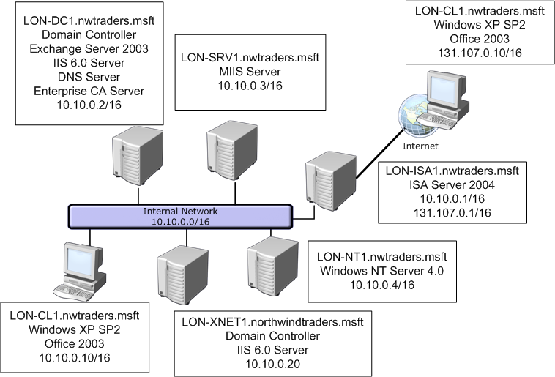
Introducing the Case-Study Scenario

Slide 39
Defining the Security Assessment Scope
Components | Scope
Target | LON-SRV1.nwtraders.msft
Timeline | Scanning will take place December 2 during noncritical business hours
Assess for the following vulnerabilities | Buffer overflow SQL injection Guest account enabled RPC-over-DCOM vulnerability

Slide 40
Defining the Security Assessment Goals
Project goal
LON-SRV1 will be scanned for the following vulnerabilities and will be remediated as stated
Vulnerability | Remediation
SQL Injection | Require developers to fix Web-based applications
Buffer Overflow | Have developers fix applications as required
Guest account enabled | Disable guest account
RPC-over-DCOM vulnerability | Install Microsoft security update MS04-012

Slide 41
Choosing Tools for the Security Assessment
The tools that will be used for the Northwind Traders security assessment include the following:
Microsoft Baseline Security Analyzer
KB824146SCAN.exe
Portqry.exe
Manual input

Slide 42
Reporting the Security Assessment Findings
Answer the following questions to complete the report:
What risk does the vulnerability present?
What is the source of the vulnerability?
What is the potential impact of the vulnerability?
What is the likelihood of the vulnerability being exploited?
What should be done to mitigate the vulnerability?
Give at least three options if possible
Where should the mitigation be done?
Who should be responsible for implementing the mitigations?

Slide 43
Summary
ü
Plan your security assessment to determine scope and goals
Disclose only essential information about your organization on Web sites and on registrar records
ü
Assume that the attacker already knows the exact operating system and version and take as many steps as possible to secure those systems
ü
ü
Educate users to use strong passwords or pass-phrases
Keep systems up-to-date on security updates and service packs
ü

Slide 44
More information
www.microsoft.se/technet
www.microsoft.se/security
www.truesec.se/events
www.itproffs.se

